Slide 1
DECISION TREE BASED TOURISM RECOMMENDATION SYSTEM
MAIN PROJECT
Department Of MCA,MES college Of Engineering,Kuttippuram
14th september 2022

Slide 2
PREPARED BY
AFRA N K(MES21MCA-2001)
GUIDED BY
Mr.HYDERALI K
HEAD OF DEPARTMENT
MASTER OF COMPUTER APPLICATIONS
MES COLLEGE OF ENGINEERING,KUTTIPPURAM

Slide 3
Contents
Introduction
Modules
Existing System
Proposed System
Developing Environment
Data Flow Diagram
User Story
Product Backlog
Project Plan
Sprint Plan

Slide 4
INTRODUCTION
Choosing a tourist destination from the information that is available on the Internet and through other sources is one of the most complex tasks for tourists when planning travel, both before and during travel. Tourism Recommendation System (TRS) provide suggestions to the tourists to identify the most suited transport (flight, train, etc.), accommodations, museums, special interest places and other items which are required for the trip.

Slide 5
The system is developing in Django framework that is in Python.This System contains modules like Admin,Experts,Travel Agencies and The user. Admin has the overall control in the system.Whereas experts controls several functions like they adding and managing Tourist places and Travel agencies,Can view and deals with the complaints of the users about Travel agencies etc. Travel agencies Provides different kinds of Trip Packages to users,taking bookings of users and update booking status etc.

Slide 6
MODULES
ADMIN:-
Admin can login to the system
Admin has the overall control in the system
Admin manages the experts in the system
Manages the categories of Tourist places
EXPERTS:-
They can login with their username and password.
Can view the categories of places
Can add and manage places.and their specialitits.
View Complaints and send replies .
Providing the nearest available travel agencies and providing information about travel agencies.
Block or unblock travel agencies.

Slide 7
TRAVEL AGENCY:-
Travel agencies can login to the system.
They add different budgets of their packages of tourist places.
They Managing budget information
They can view bookings of the customers and update status of booking whether booked or not.

Slide 8
USER:-
User register and login to the system.
User can looking for places for their travel
User gives information about their duration of the travel to the system.
User can rate places.
User can also add places that are nonpopular.
User can search the near by places.
The system recommends to the user places for travel according to their details.

Slide 9
Existing System
Nowadays, many people rely on online services to plan a trip. However, they are usually faced with the problem of being supplied with lots of information. In consequence, they have to invest a great deal of time to decide what to visit, when, etc. This huge amount of possibilities available on the net makes it difficult for users to discern the more interesting offers from the rest. As a result, the more appealing offers can go unnoticed. In order to improve the tourist experience, recommender systems offer personalised information to users. In other words, the system selects the more suitable and adequate offers for users and offers activities appropriate to their profile.Tourists can find tourism information on blogs, forums, websites of points of interest etc. However, information overflow can occur on the internet as there is still a lack of focus on the use of recommender technology in the tourism field.

Slide 10
Proposed System
During a trip, tourists need to be able to obtain tour information in a timely manner whenever there are any changes in their planned trip. Recommendation of tour information is vital for users, for the recommendation system to succeed; it must be able to provide tourism information based on the user’s preferences and current location. There is also increasing demand for more information on local area attractions, such as local food, shopping spots, places of interest and so on during the tour.To propose a framework for a Decision tree-based Tourism Recommendation System. System will find out recommendation list of city wise tourist places and hotels using AI techniques Logged in users profile analysis and profile wise collaborative filtering Specified city wise tourist places re-ranking depending upon their ratings and reviews User will select particular place to view its details Selected place wise hotels re-ranking depending upon hotels ratings and reviews Result delivery with hotels and place details.

Slide 11
Developing Environment
Hardware Specification
Processor : Intel Core i7
HDD : 256GB
RAM : 16GB or above
Software Specification
Operating System : Windows 10 or above
Front End : Django
Back End : MySQL
IDE : Pycharm
Browser : Chrome

Slide 12
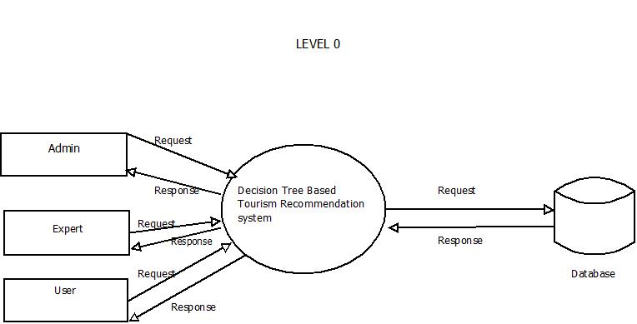
DATA FLOW DIAGRAM

Slide 13
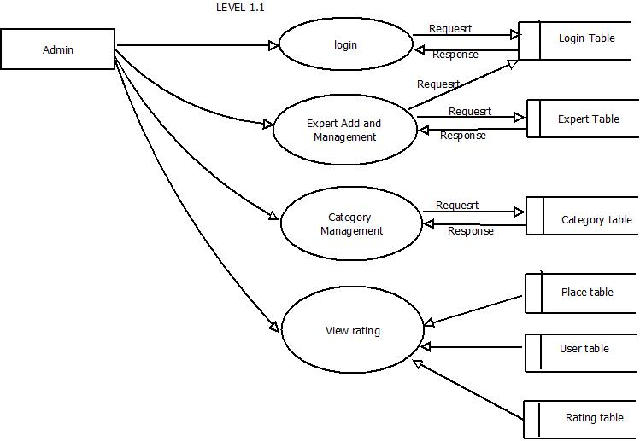

Slide 14
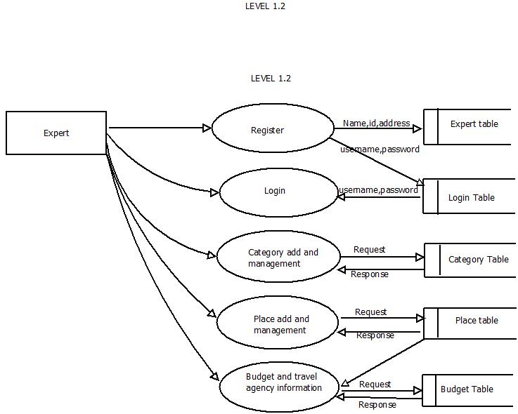

Slide 15
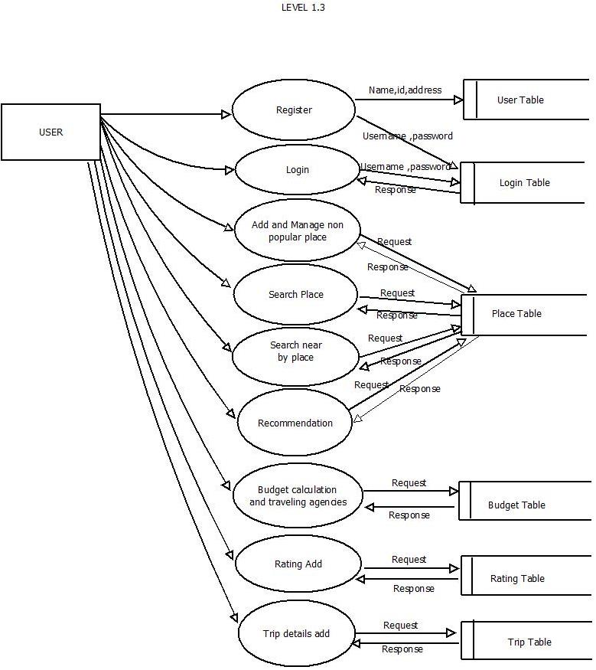

Slide 16
USER STORY
Story ID | As a <Type of user> | I Want to | So that I can
1C | Admin | Login | Access Entire page
2 | Admin | Approve Travel Agency | To approve travel agency
3 | Admin | Expert add and Manage | To manage all the task of Expert
4 | Admin | Category Add | To Add category
5 | Admin | Category Management | To manage category
6 | Admin | View rating | view
7 | Admin | Admin Home | To Enter Admin Functions

Slide 17
Story ID | As a <Type of user> | I Want to | So that I can
8 | Expert | Register | Enter Details
9 | Expert | login | Access Entire page
10 | Expert | Manage Place details | To manage place details
11 | Expert | View Complaints | To view complaints
12 | Expert | Send Reply | Send Replies
13 | Expert | Add Place Details | To add place details
14 | Expert | Manage travel agency information | manage budget and provide TA information

Slide 18
Story ID | As a <Type of user> | I Want to | So that I can
15 | Expert | Add travel agency information | Add budget and provide TA information
16 | Expert | Block and Unblock Travel Agency | To Block Unblock travel agency
17 | Expert | Expert Home | To Enter expert functions
18 | Expert | View Category | To View Category
19 | Travel Agency | Add Budget | To add budget info
20 | Travel Agency | Manage budget information | Manage budget informations
21 | Travel Agency | TA Home | To Create TA Home

Slide 19
Story ID | As a <Type of user> | I Want to | So that I can
22 | Travel Agency | View Booking info and update status | To view booking info and update status
23 | User | Register | Enter Details
24 | User | Login | Access Entire Access
25 | User | Add and manage non popular places | Add and manage non popular places
26 | User | Search Place | Search for places
27 | User | Search Near By Places | Search for non popular places

Slide 20
Story ID | As a <Type of user> | I Want to | So that I can
28 | User | Recommendation | Get recommendation
29 | User | Calculate budget And and travel agencies | Calculate budget
30 | User | Add rating | Rate Place
31 | User | Add Trip details | Add trip details

Slide 21
Product Backlog
ID | NAME | PRIORITY
1 | Login | High
2 | Approve Travel Agency | High
3 | Expert add and Manage | Medium
4 | Category Add | High
5 | Category Management | Medium
6 | View rating | Medium
7 | Admin Home | High
User Story ID
Priority
<High/Medium/Low>
Size
(Hours)
Sprint<#>
Status
<Planned/In
progress/Completed
Release
Date
Release
Goal
1
Medium
2
1
completed
Table Design
2
High
3
completed
Form Design
3
High
5
2
Planned
Basic coding
3
Medium
5
Planned
Registration
4
High
5
3
Planned
Change database
5
High
5
Planned
Post questions
6
High
5
4
Planned
Post answer
7
Medium
5
Planned
Reply to answer
8
High
5
Planned

Slide 22
cID | NAME | PRIORITY
8 | Register | High
9 | login | High
10 | Manage Place details | Medium
11 | View Complaints | Medium
12 | Send Reply | Medium
13 | Add Place Details | Medium
14 | Manage travel agency information | Medium

Slide 23
cID | NAME | PRIORITY
15 | Add travel agency information | Medium
16 | Block and Unblock Travel Agency | Medium
17 | Expert Home | High
18 | View Category | Medium
19 | Register | High
20 | Login | High
21 | Add and manage non popular places | Medium

Slide 24
ID | NAME | PRIORITY
22 | Add Budget | Medium
23 | Manage budget information | Medium
24 | TA Home | High
25 | View Booking info and update status | Medium
26 | Search Place | High
27 | Search Near by Places | Medium

Slide 25
ID | NAME | PRIORITY
28 | Recommendation | High
29 | Calculate budget And and travel agencies | High
30 | Add rating | Medium
31 | Add Trip details | Medium

Slide 26
Project Plan
USERSTORY_ID | SPRINT | START DATE | END DATE | DAY | STATUS
1 2 3 4 5 6 7 8 | Sprint 1 | 07/02/2023 | 28/02/2023 | 21 | completed
9 10 11 12 13 14 15 16 | Sprint 2 | 01/03/2023 | 15/03/2023 | 15 | completed

Slide 27
USERSTORY_ID | SPRINT | START DATE | END DATE | DAY | STATUS
17 18 19 20 21 22 23 24 | Sprint 3 | 16/03/2023 | 16/04/2023 | 28 | planned
25 26 27 28 29 30 31 | Sprint 4 | 20/04/2023 | 20/05/2023 | 28 | planned

Slide 28
Sprint Plan 1
BACKLOG ITEM | COMPLETION DATE | ORIGINAL ESTIMATE | DAY 1 07/02 | DAY 2 10/02 | DAY 3 18/02 | DAY 4 19/02 | DAY 5 20/02 | DAY 6 21/02 | DAY 7 22/02 | DAY 8 23/02 | DAY 9 24/02 | DAY 10 25/02
USER STORY #1 |  | HRS | HRS | HRS | HRS | HRS | HRS | HRS | HRS | HRS | HRS | HRS
FORM DESIGN | 07/02 | 1 | 1 | 0 | 0 | 0 | 0 | 0 | 0 | 0 | 0 | 0
TABLE DESIGN | 15/02 | 1 | 0 | 0 | 1 | 0 | 0 | 0 | 0 | 0 | 0 | 0
CODING | 21/02 | 4 | 0 | 0 | 0 | 0 | 1 | 1 | 1 | 0 | 1 | 0
TESTING&VALIDATION | 26/02 | 1 | 0 | 0 | 0 | 0 | 0 | 0 | 0 | 0 | 0 | 1

Slide 29
Sprint Plan 2
BACKLOG ITEM | COMPLETION DATE | ORIGINAL ESTIMATE | DAY 1 01/03 | DAY 2 05/02 | DAY 3 07/02 | DAY 4 08/02 | DAY 5 09/02 | DAY 6 10/02 | DAY 7 11/02 | DAY 8 12/02 | DAY 9 13/02 | DAY 10 14/02
USER STORY #1 |  | HRS | HRS | HRS | HRS | HRS | HRS | HRS | HRS | HRS | HRS | HRS
FORM DESIGN | 01/03 | 1 | 1 | 0 | 0 | 0 | 0 | 0 | 0 | 0 | 0 | 0
TABLE DESIGN | 07/03 | 1 | 0 | 0 | 1 | 0 | 0 | 0 | 0 | 0 | 0 | 0
CODING | 09/03 | 4 | 0 | 0 | 0 | 0 | 1 | 1 | 1 | 0 | 1 | 0
TESTING&VALIDATION | 14/03 | 1 | 0 | 0 | 0 | 0 | 0 | 0 | 0 | 0 | 0 | 1

Slide 30
Sprint Plan 3
BACKLOG ITEM | COMPLETION DATE | ORIGINAL ESTIMATE | DAY 1 16/03 | DAY 2 17/03 | DAY 3 18/03 | DAY 4 19/03 | DAY 5 20/03 | DAY 6 21/03 | DAY 7 08/04 | DAY 8 09/04 | DAY 9 `14/04 | DAY 10 16/04
USER STORY #1 |  | HRS | HRS | HRS | HRS | HRS | HRS | HRS | HRS | HRS | HRS | HRS
FORM DESIGN | 16/03 | 1 | 1 | 0 | 0 | 0 | 0 | 0 | 0 | 0 | 0 | 0
TABLE DESIGN | 20/03 | 1 | 0 | 0 | 1 | 0 | 0 | 0 | 0 | 0 | 0 | 0
CODING | 09/04 | 4 | 0 | 0 | 0 | 0 | 1 | 1 | 1 | 0 | 1 | 0
TESTING&VALIDATION | 16/04 | 1 | 0 | 0 | 0 | 0 | 0 | 0 | 0 | 0 | 0 | 1

Slide 31
Sprint Plan 4
BACKLOG ITEM | COMPLETION DATE | ORIGINAL ESTIMATE | DAY 1 20/04 | DAY 2 24/04 | DAY 3 26/04 | DAY 4 09/05 | DAY 5 10/05 | DAY 6 12/05 | DAY 7 14/05 | DAY 8 15/05 | DAY 9 17/05 | DAY 10 19/05
USER STORY #1 |  | HRS | HRS | HRS | HRS | HRS | HRS | HRS | HRS | HRS | HRS | HRS
FORM DESIGN | 20/04 | 1 | 1 | 0 | 0 | 0 | 0 | 0 | 0 | 0 | 0 | 0
TABLE DESIGN | 26/04 | 1 | 0 | 0 | 1 | 0 | 0 | 0 | 0 | 0 | 0 | 0
CODING | 09/05 | 4 | 0 | 0 | 0 | 0 | 1 | 1 | 1 | 0 | 1 | 0
TESTING&VALIDATION | 19/05 | 1 | 0 | 0 | 0 | 0 | 0 | 0 | 0 | 0 | 0 | 1

